Slide 1
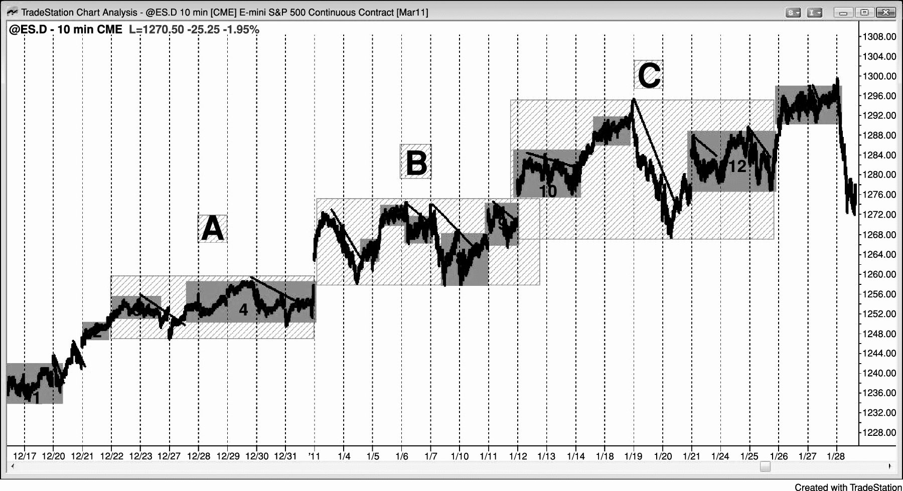
FIGURE PIV.1 Most of the Bars on Any Chart Are within Trading Ranges

Slide 2
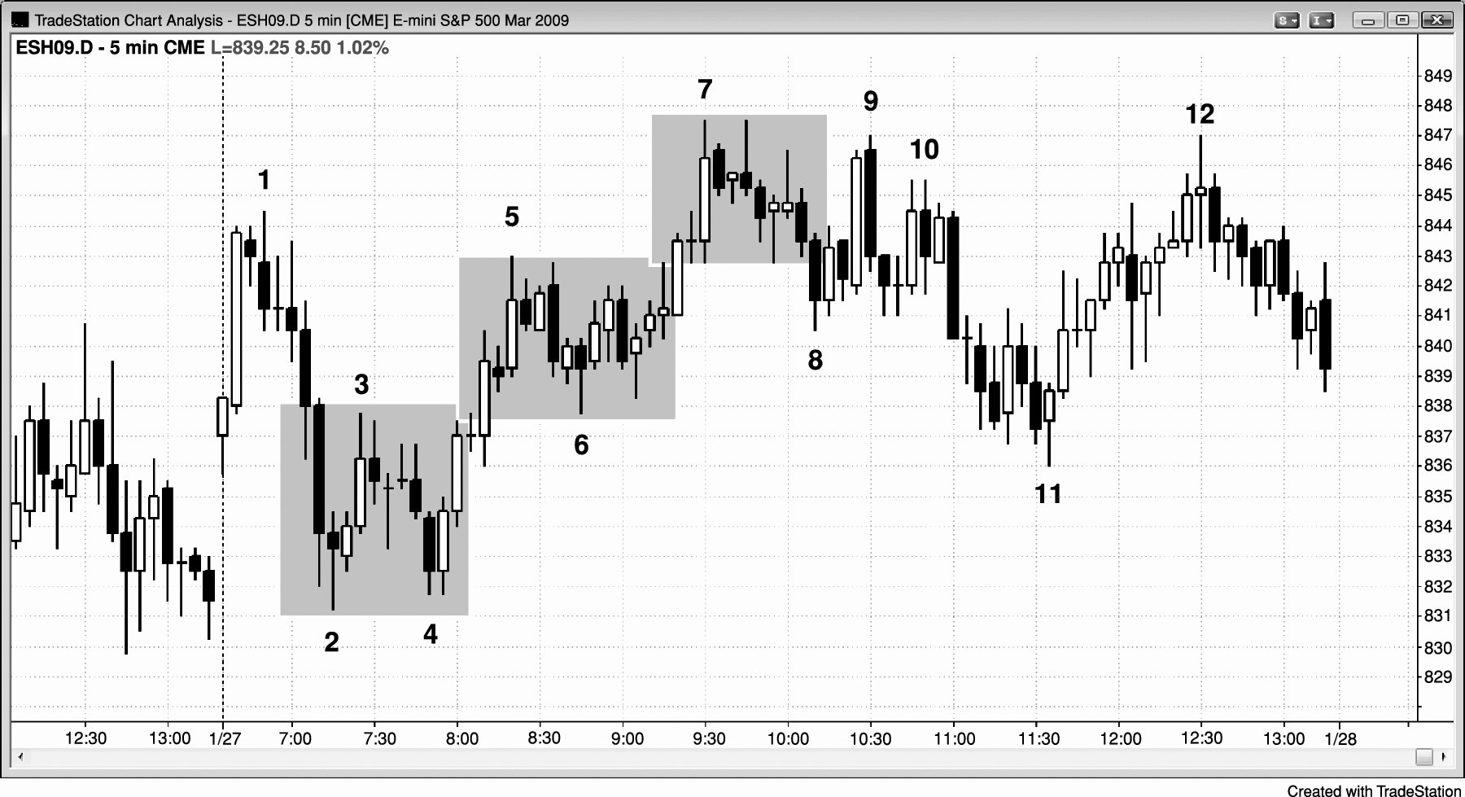
FIGURE PIV.2 Multiple Early Reversals Often Lead to a Trading Range Day

Slide 3
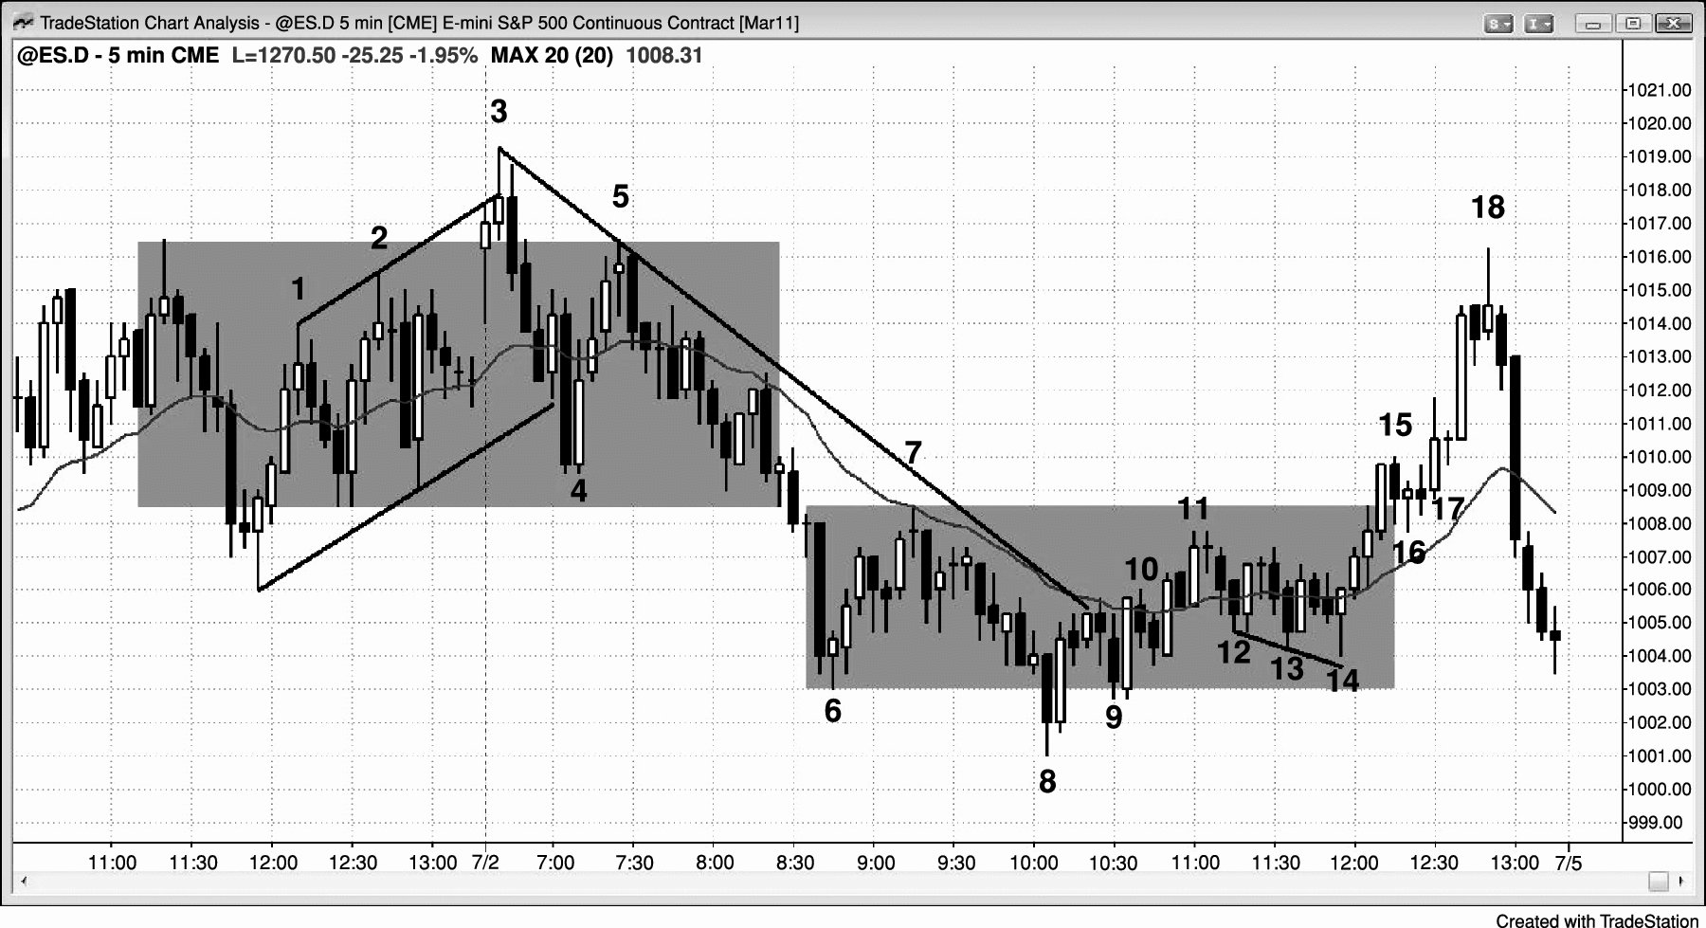
FIGURE PIV.3 Swing Trades in Trading Ranges

Slide 4
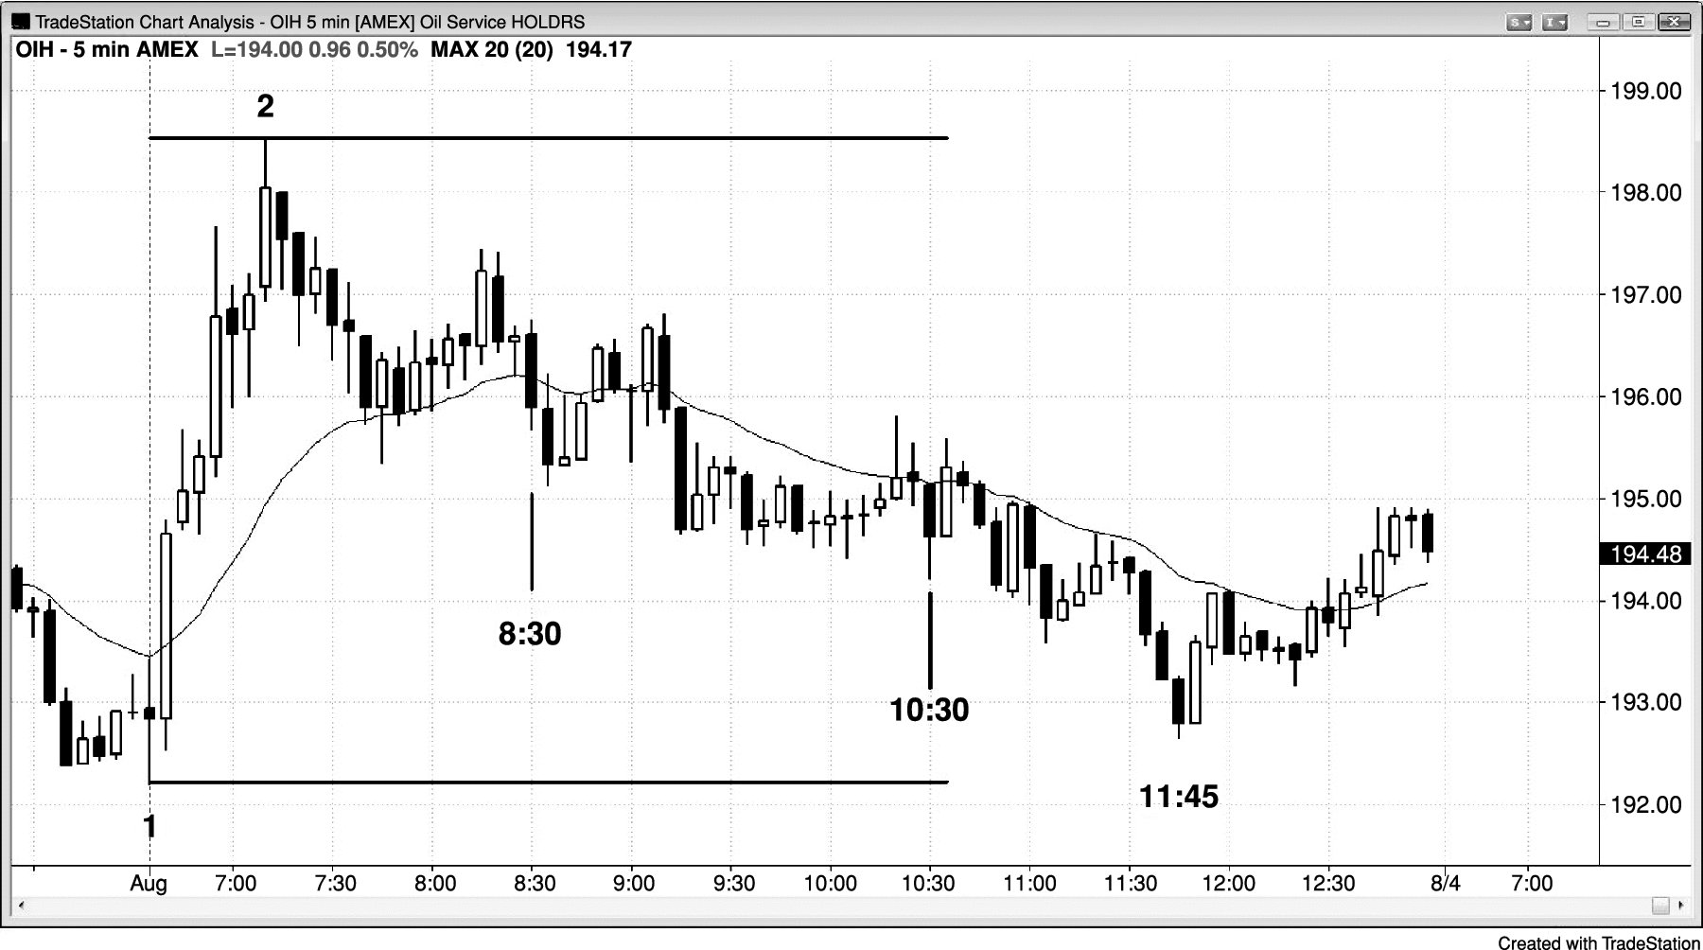
FIGURE PIV.4 Middle Third of the Range and of the Day

Slide 5
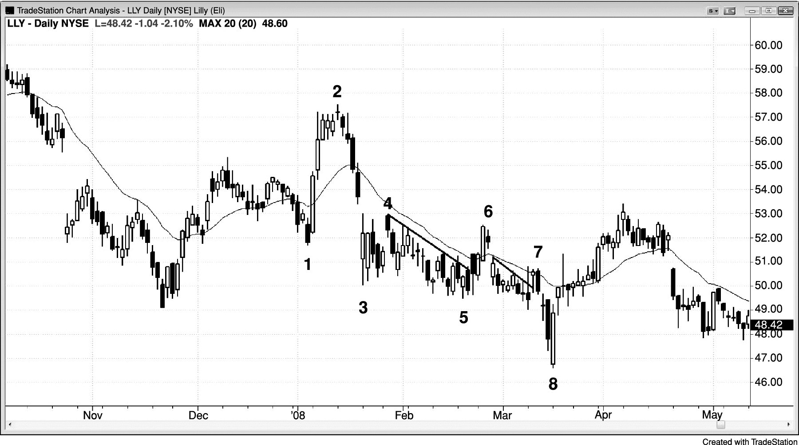
FIGURE PIV.5 Spike Up and Then Down Usually Leads to a Trading Range

Slide 6
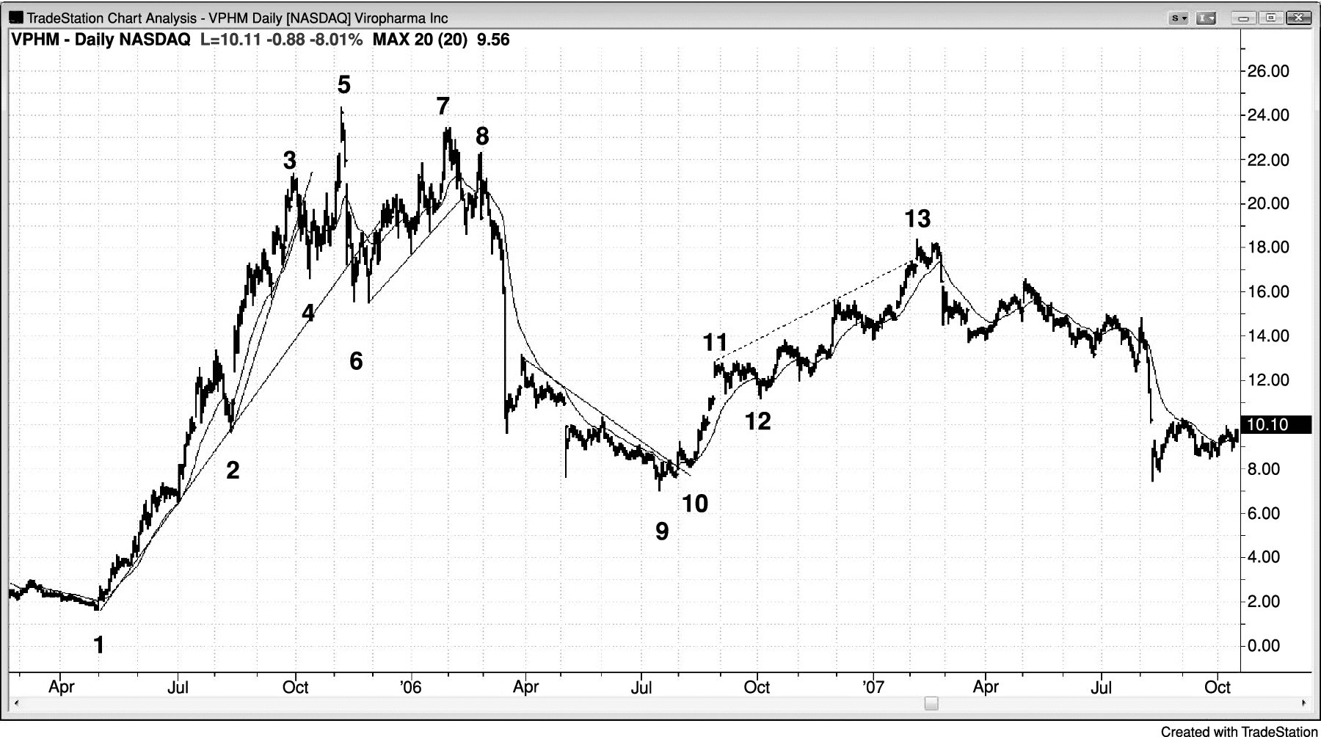
FIGURE PIV.6 Pullbacks Can Grow into Trading Ranges

Slide 7
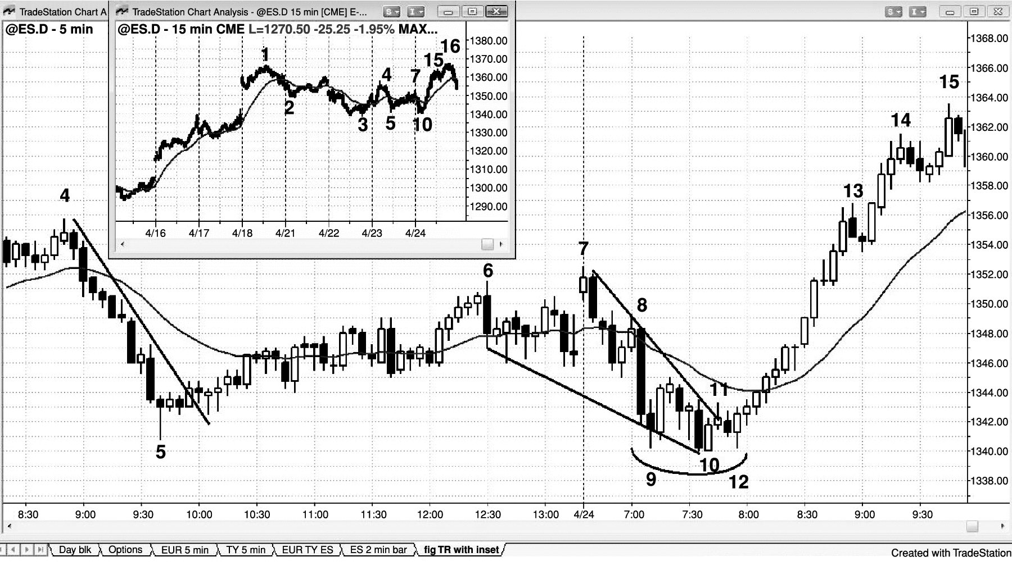
FIGURE PIV.7 A Trading Range Can Be a Reversal Setup

Slide 8
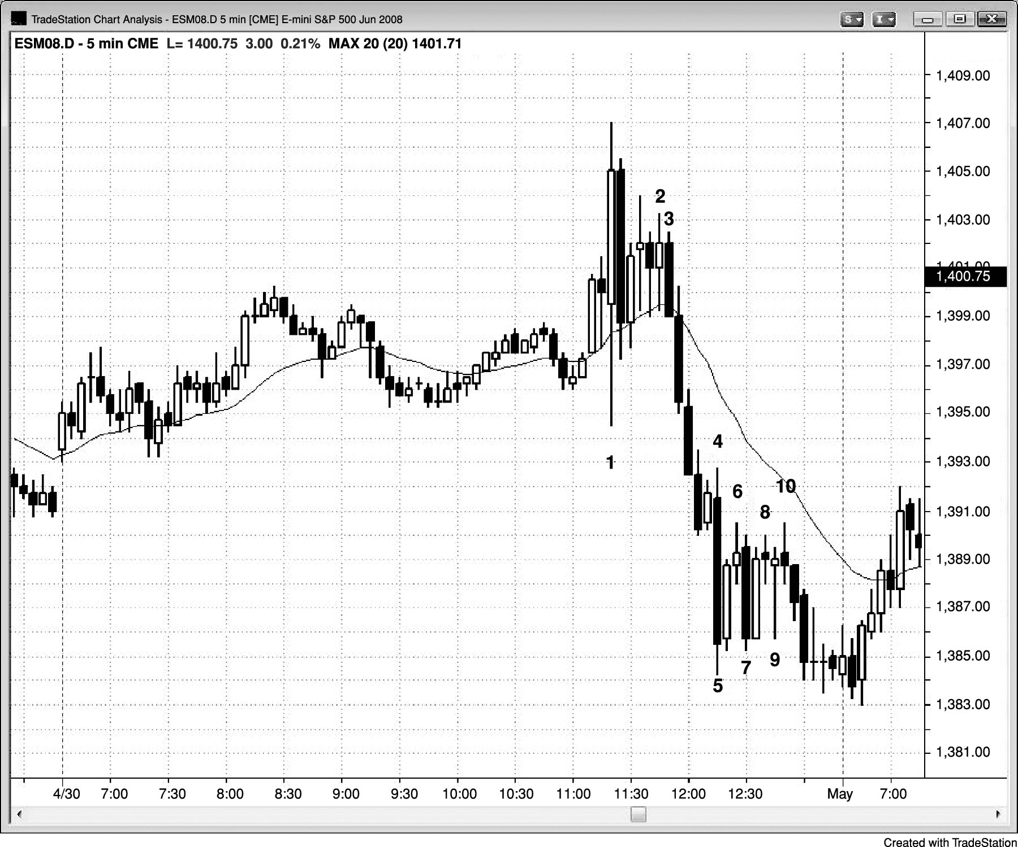
FIGURE PIV.8 Buy Climax, Then Trading Range

Slide 9
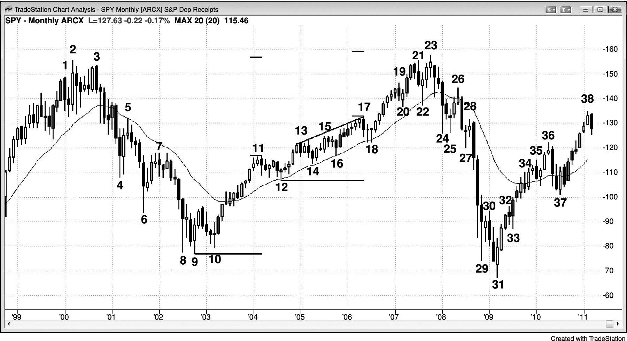
FIGURE PIV.9 Trading Ranges Leading to Reversals

